Slide 1
Greythorn Primary School KS2 Y3/4 Maths Presentation

Slide 2
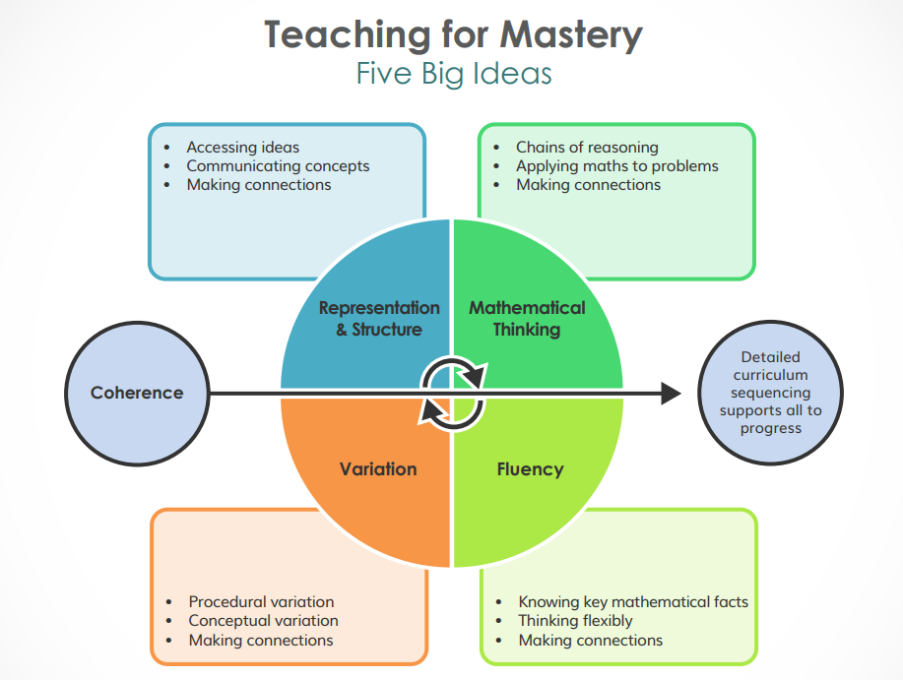
Mastery Maths

Slide 3
Features of Mastery Maths
Fluency- number facts, writing numerals
Automaticity in number- number bonds, 1 more, 1 less, 10 more, 10 less, tables
Reasoning- what if? What comes next? Is that the only answer? Is that the quickest method?
Promoting curiosity
Problem Solving- applying methods to real life problems
Showing resilience and perseverance and thinking creatively about problems

Slide 4
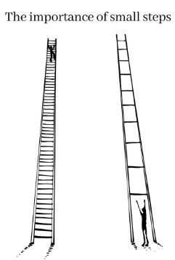
Features of Mastery Maths
Reactivating prior knowledge
Modelling methods
Working together to practise the maths
Using structures that support the learning
Using manipulatives that aid the understanding
Identifying misconceptions
Giving varied practice
Using small steps
Independent practice

Slide 5
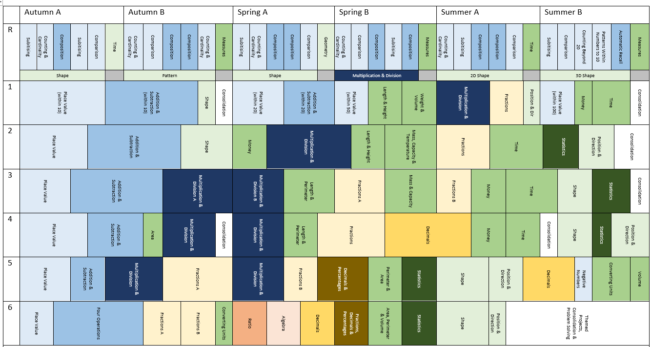
Overview of maths at Greythorn
Insert White Rose overview
Summary of year group maths

Slide 6
Concrete, abstract, pictorial

Slide 7
Maths in Y3/4
Reactivate prior knowledge (5 in 5 arithmetic)
Teach and model the new learning
Look at common misconceptions
Work together as a class on some varied problems
Work independently on varied practice
Reflect on learning
Extra 15 minutes for times tables practice
What does a lesson look like?

Slide 8
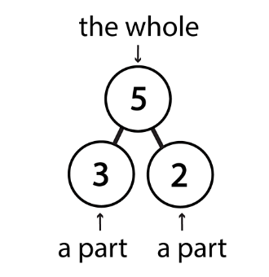
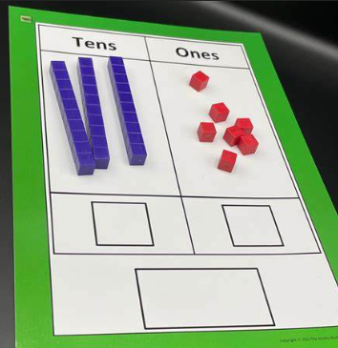
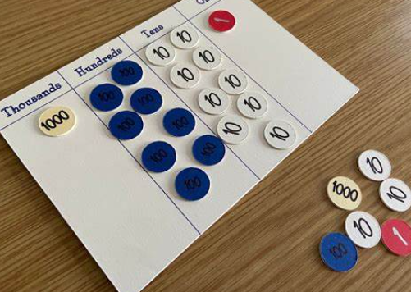
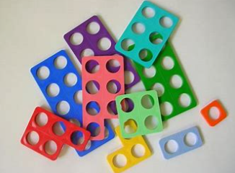
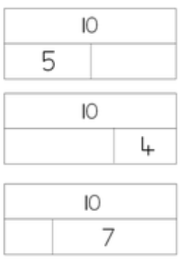
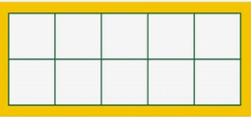
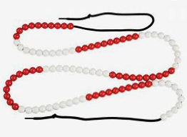
Structures and Manipulatives

Slide 9
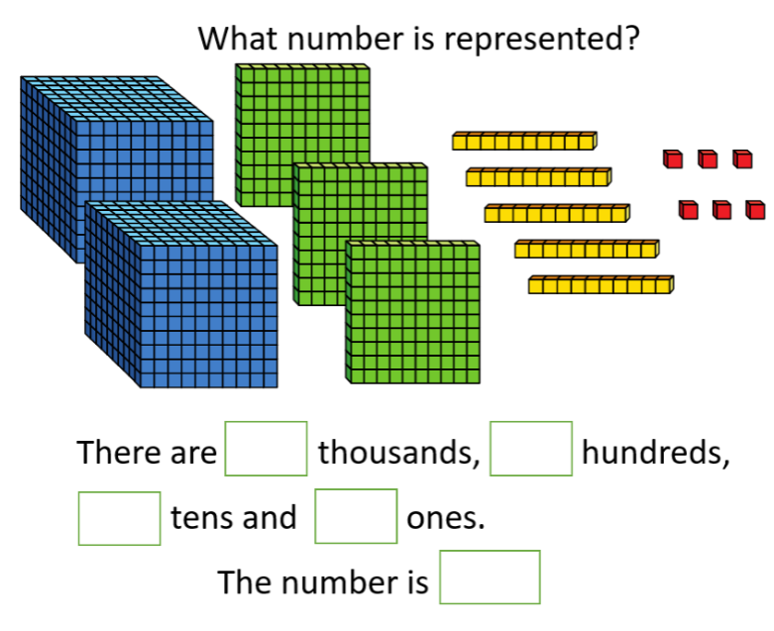
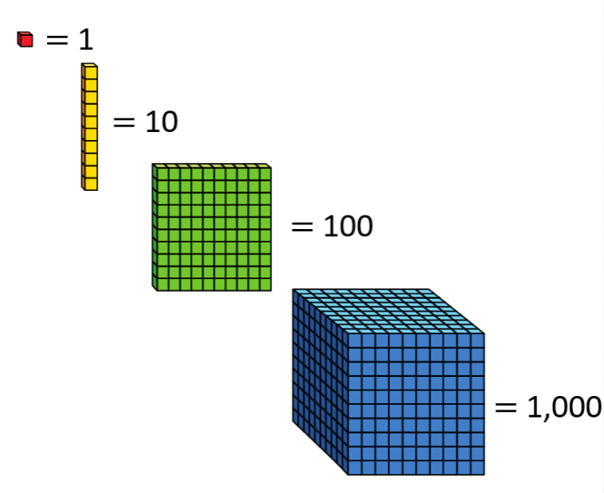
How we use structures and manipulatives in a maths lesson
Dienes gives children a sense of the size of the number

Slide 10
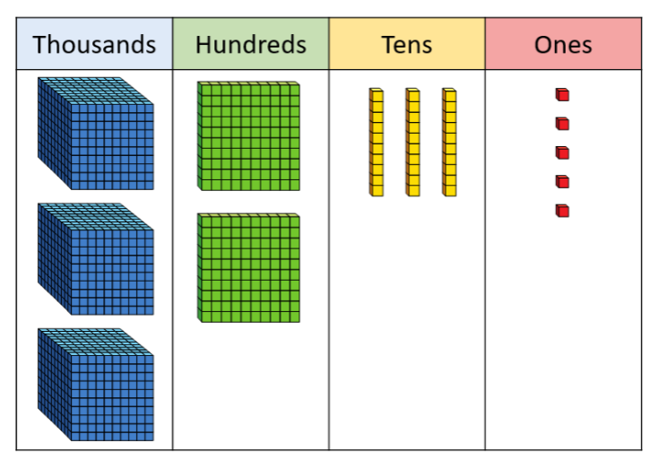
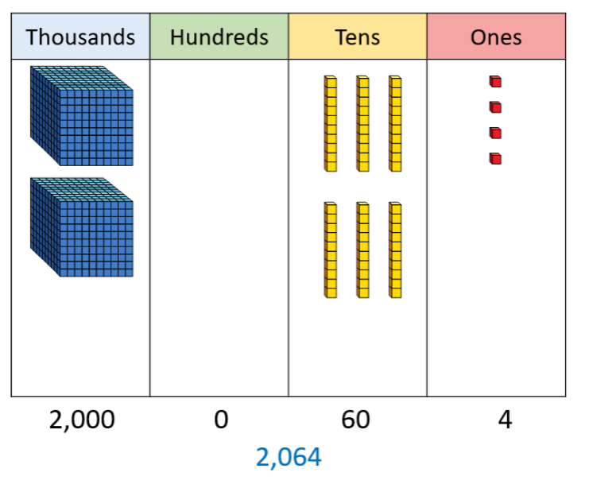
Explain misconception with the 0 place holder

Slide 11
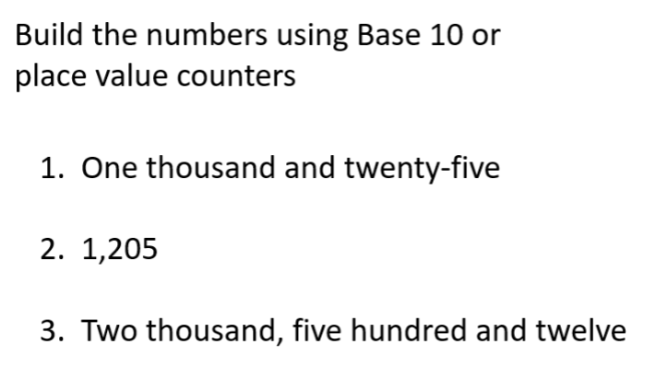
Working together to practise

Slide 12
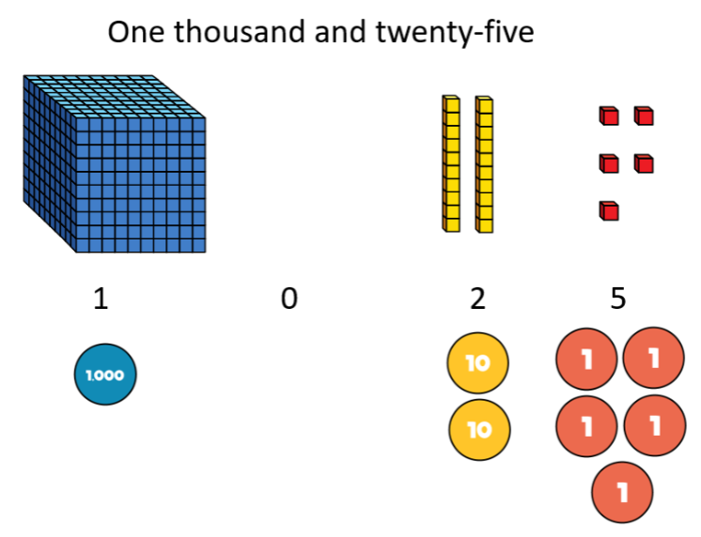
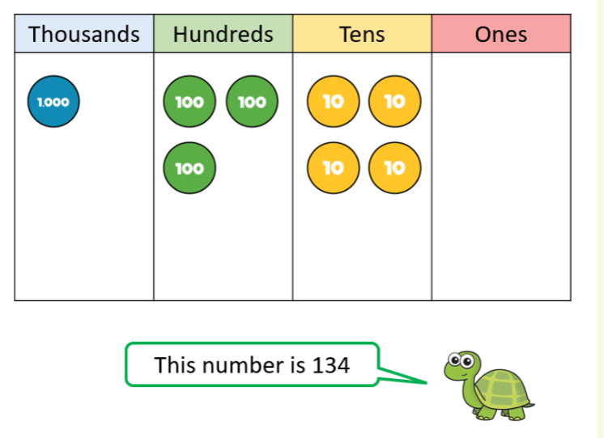
Introduce different manipulative (place value counters with the place value grid)

Slide 13
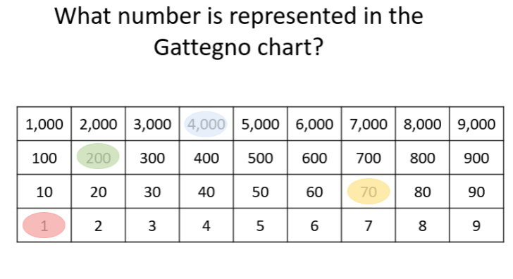
Gattegno chart and comparing representations

Slide 14
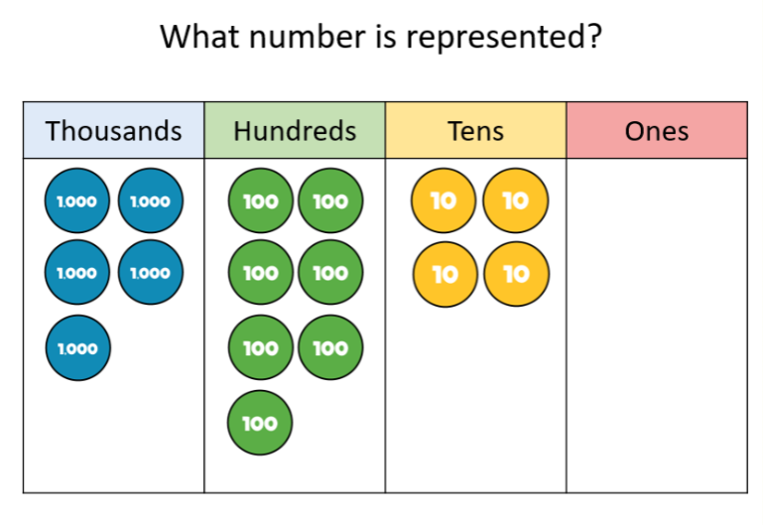
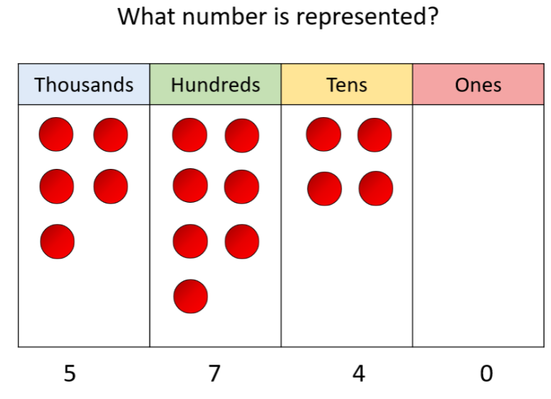
Introducing counters without the place value on

Slide 15
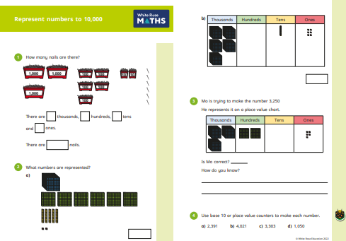
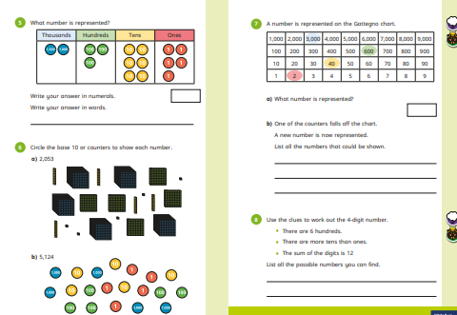

Slide 16
How to encourage your child.
The best thing that parents and carers can do for children is to have a positive attitude towards maths. Please don't say things like "I can’t do maths" or "I hated maths at school"; your child might start to think like that themselves.
Point out the maths in everyday life. Include your child in activities involving maths such as using money, cooking and travelling.
Praise your child for effort rather than talent - this shows them that by working hard they can always improve
Help your child to learn their multipication tables and support them in practising standard arithmetic methods

Slide 17
Parent Resources- free
Top Marks www.topmarks.co.uk
Maths bot www.mathsbot.com
Hit the button www.hitthebutton.com
Ixl https://uk.ixl.com/
TTRS – all children have their login. Please do not allow other friends/family members to go on your child’s account

