Slide 1
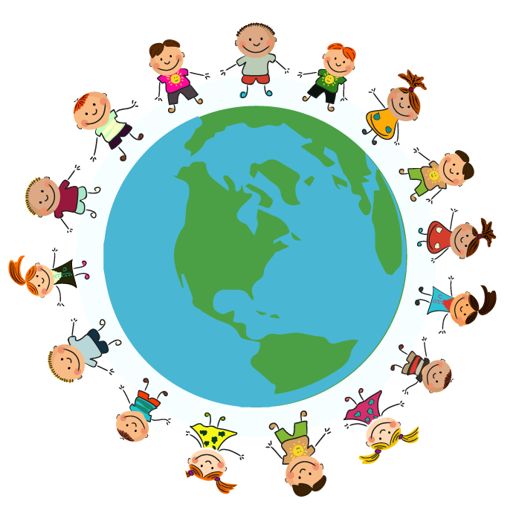
.
Greythorn Primary School Year Group: Foundation Term : Autumn 2
Communication and Language
‘How can we light up the World?’
Maths
Children will accurately use and understand the numbers 1-10. They will group objects and understand the terms more and fewer. Children will then develop their subitising and ordinality skills further. Children will start to learn the different shapes and identify these in the environment. They will learn and use positional language.
Children will talk about their families. They will listen to each other and share their own experiences. They will ask questions of each other to find out more information. Children will use vocabulary from their PSED lessons in their discussions.
Physical Development
Reading
Children will create a dance piece based on fireworks using scarves and streamers. They will explore different speeds and directions. Children will start to develop their catching and throwing techniques using a range of different balls. They will also learn how to dribble a ball and shoot into a goal.
Children will learn the appropriate sounds from Read, Write Inc based on their level of need.
Children will look at at range of wider texts linked to our stories of the week with a focus on key vocabulary and blending to read words with taught GPC’s.
We can light up the World in many ways. We will look at different celebrations across the World.
Personal, Social, Emotional Development
Expressive Arts and Design
Understanding the World
Writing
Children will look at celebrating difference and talk about their likes and dislikes. Children will look at how families can be different, yet all important. Children will explore being respectful and sensitive to others and learn how to cooperate with others.
Children will start to write the all letters of the alphabet accurately. They will write simple words and then build these into writing a sentence. Children will start to write plans for their own recount of a familiar text and learn how to write for a purpose in the form of a poster.
Children will create artwork using a range of media from collage, clay, paint. They will produce firework/poppy prints, Diva lamps and Advent wreaths. Children will learn to sing a range of traditional songs to perform at the annual Christmas singalong.
Children will learn about special celebrations from around the world across different faiths. These include Eid, Diwali, Vaisakhi, Christmas, Advent & Hanukkah. They will learn about why and how each one is celebrated.

